Slide 1

Python Programming
Zoom session - Part II
Compiled by: Ndede, Migot G.

Slide 2
Lesson 11: Operator Overloading
Each operator can be used in a different way for different types of operands. For example, + operator is used for adding two integers to give an integer as a result but when we use it with float operands, then the result is a float value and when + is used with string operands then it concatenates the two operands provided.
This different behavior of a single operator for different types of operands is called Operator Overloading. The use of + operator with different types of operands is shown below:

Slide 3
Operator Overloading
Operator Overloading is achieved by defining a special method in the class definition. The names of these methods starts and ends with double underscores (__). The special method used to overload + operator is called __add__().
Both int class and str class implements __add__() method. The int class version of the __add__() method simply adds two numbers whereas the str class version concatenates the string.

Slide 4
Operator Overloading
If the expression is for the form x + y, Python interprets it as x.__add__(y). The version of __add__() method called depends upon the type of x and y. If x and y are int objects then int class version of __add__() is called. On the other hand, if x and y are list objects then list class version of __add__() method is called.

Slide 5
Operator Overloading
Operator overloading is helpful in cases where the operators used for certain types provide semantics related to the domain context and syntactic support as found in the programming language. It is used for syntactical convenience, readability and maintainability.
We can overload all existing operators but we can’t create a new operator. To perform operator overloading, Python provides some special function or magic function that is automatically invoked when it is associated with that particular operator. For example, when we use + operator, the magic method __add__ is automatically invoked in which the operation for + operator is defined.

Slide 6
Operator Overloading
>>> x, y = 10, 20
>>> x + y
30
>>> x.__add__(y) # same as x + y
30
>>> x, y = [11, 22], [1000, 2000]
>>> x.__add__(y) # same as x + y
[11, 22, 1000, 2000]

Slide 7
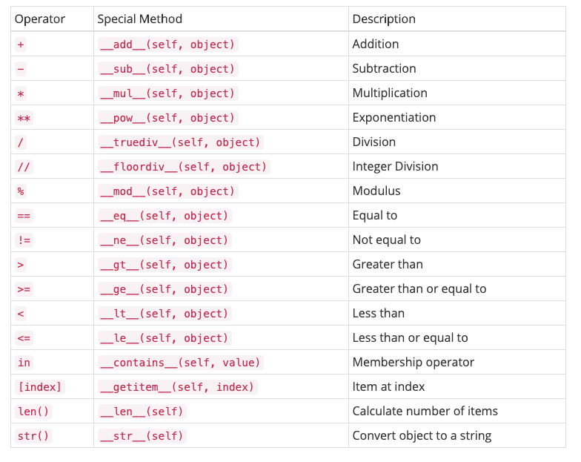

Slide 8
Operator Overloading
Notice that last two items in table are not operators instead they are built-in functions. But if you want to use then with your class you should define their respective special methods.
Examples to use in Zoom Class;
https://colab.research.google.com/drive/1AdyauS7YPGCIKwV_F_7UsNljIZPHvDGC#scrollTo=jbVJBB8Yah18
https://colab.research.google.com/drive/12kVg1JQzZ_-s-o_wvh-rM_FX9WJGCeAS

Slide 9
Operator Overloading
Operator overloading is used to customize the function of an operator (e.g., +,*,<,== etc.) for a user-defined class. It is necessary to overload the operator we want to use with the user-defined data type, without it, the compiler does not know which variables of the user-defined type to add, multiply, or compare.
In Python programming, overloading is achieved by overriding the method which is specifically for that operator, in the user-defined class. For example, __add__(self, x) is a method reserved for overloading + operator, and __eq__(self, x) is for overloading ==.

Slide 10
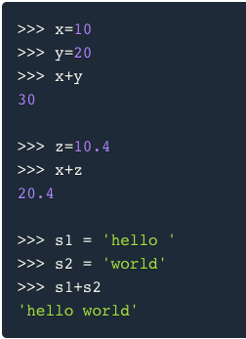
Operator Overloading

Slide 11
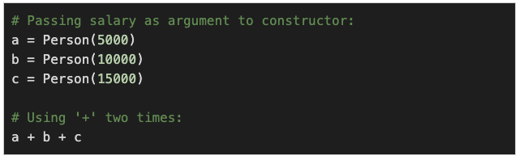
Operator Overloading
Chaining
In the context of operator overloading, chaining is when you use an operator multiple times in the same line:

Slide 12
Operator Overloading
To make an overloaded operator capable of performing chaining, we usually return the same user-defined type in the overloading function:
def __add__(self, xy): return Person(self.salary + xy.salary)

Slide 13
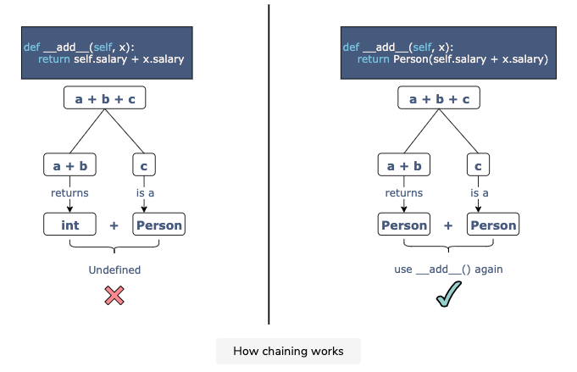
Operator Overloading

Slide 14
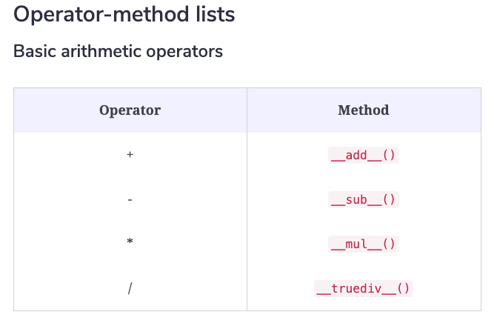
Operator Overloading

Slide 15
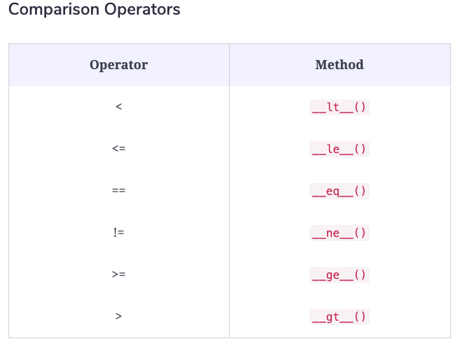
Operator Overloading

Slide 16
Operator Overloading
Can + Operator Add anything?
The answer is No, it cannot. Can you use the + operator to add two objects of a class. The + operator can add two integer values, two float values or can be used to concatenate two strings only because these behaviors have been defined in python.
So if you want to use the same operator to add two objects of some user defined class then you will have to defined that behavior yourself and inform Python interpreter about that.
If you are still not clear, let's create a class and try to use the + operator to add two objects of that class,

Slide 17
Operator Overloading
class Complex:
def __init__(self, real, imaginary):
self.real = real
self.img = imaginary
c1 = Complex(5,3)
c2 = Complex(2,4)
print("sum = ", c1+c2)

Slide 18
Operator Overloading
Output:
Traceback (most recent call last):
File "/tmp/sessions/1dfbe78bb701d99d/main.py", line 7, in
print("sum = ", c1+c2)
TypeError: unsupported operand type(s) for +: 'Complex' and 'Complex’
So we can see that the + operator is not supported in a user-defined class. But we can do the same by overloading the + operator for our class Complex. But how can we do that? Have a look at the following example.

Slide 19
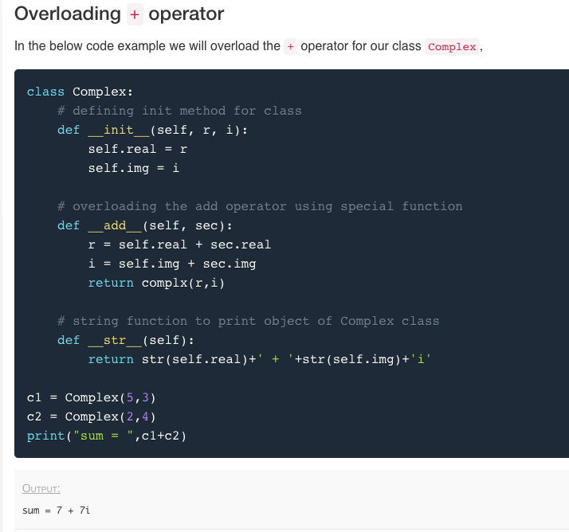
Overloading + Operator
Try the below program in this link here: https://colab.research.google.com/drive/1KEAc3WSJl4qCN9h3gP13j-V1INQFA5Cy#scrollTo=3tiR5svshagH

Slide 20
Overloading + Operator
In the program above, __add__() is used to overload the + operator i.e. when + operator is used with two Complex class objects then the function __add__() is called.
__str__() is another special function which is used to provide a format of the object that is suitable for printing.
Based on your requirement of comparing the class object, we can define the logic for the special functions for overriding an operator. In the code above, we have given precedence to the real part of the complex number, if that is less, then the whole complex number is less, if that is equal then we check for the imaginary part.

Slide 21
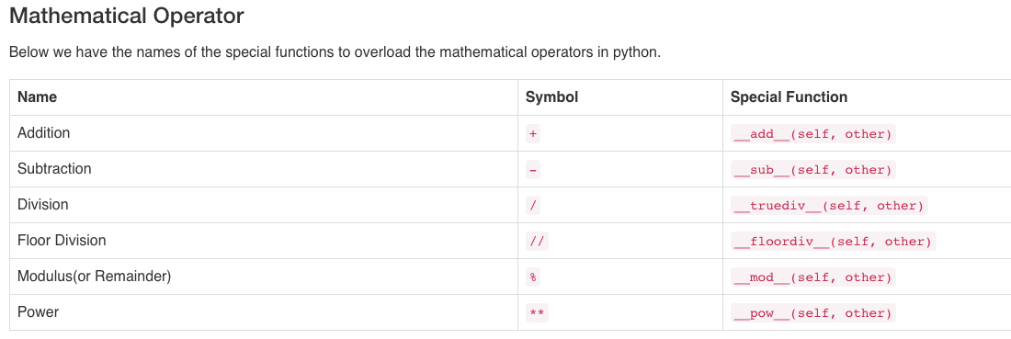
Mathematical Operators

Slide 22
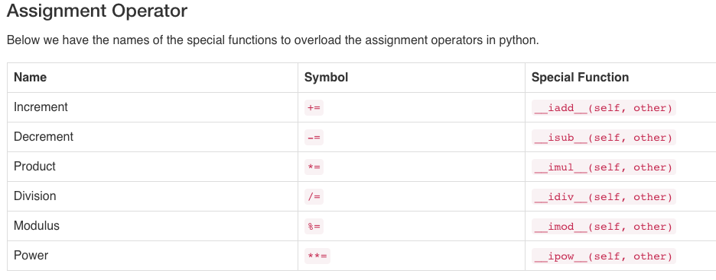
Assignment Operators

Slide 23
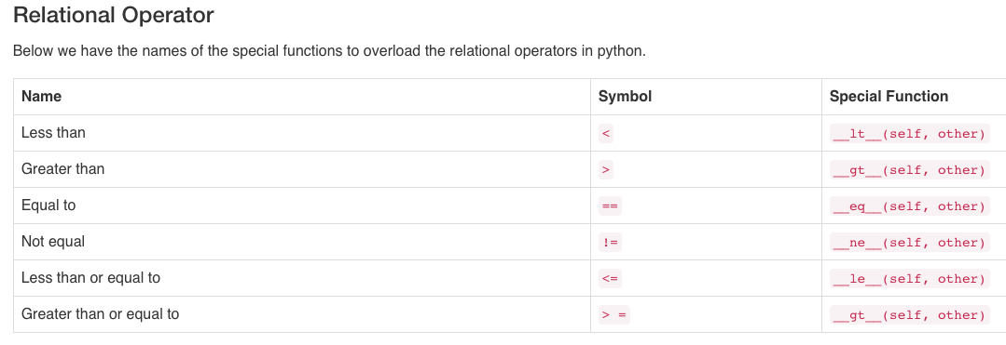
Relational Operator

Slide 24
Operator Overloading
Python operators work for built-in classes. For example, the + operator will perform arithmetic addition on two numbers, merge two lists, or concatenate two strings. This feature in Python that allows the same operator to have different meaning according to the context is called operator overloading.
This is where different operators have different implementations depending on their arguments.

Slide 25
Operator Overloading
We have already seen that we can use + operator for adding numbers and at the same time to concatenate strings.
It is possible because + operator is overloaded by both int class and str class.
The operators are actually methods defined in respective classes.
Defining methods for operators is known as operator overloading.

Slide 26
Example of Operator Overloading
To use + operator with custom objects we need to define a method called __add__.
import math
class Circle:
def __init__(self, radius):
self.__radius = radius
def setRadius(self, radius):
self.__radius = radius

Slide 27
Example of Operator Overloading
def getRadius(self):
return self.__radius
def area(self):
return math.pi * self.__radius ** 2
def __add__(self, another_circle):
return Circle( self.__radius + another_circle.__radius )
c1 = Circle(4)
print(c1.getRadius())
c2 = Circle(5)
print(c2.getRadius())

Slide 28
Example of Operator Overloading
# This became possible because we have overloaded + operator by adding a method named __add__
c3 = c1 + c2
print(c3.getRadius())
Try the program: https://colab.research.google.com/drive/1KEAc3WSJl4qCN9h3gP13j-V1INQFA5Cy

Slide 29
Example of Operator Overloading
In the above example we have added __add__() method which allows use to use the + operator to add two circle objects. Inside the __add__() method we are creating a new object and returning it to the caller.

Slide 30
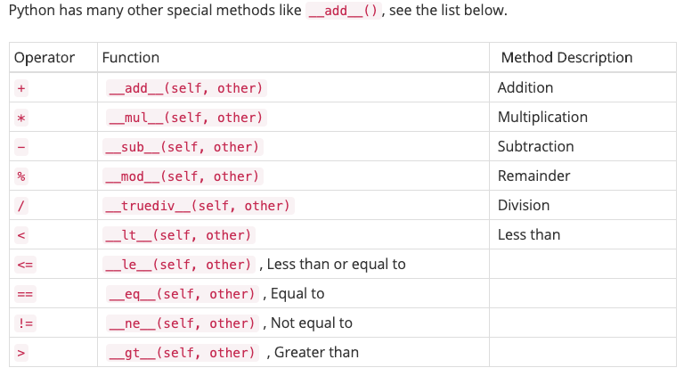
Example of Operator Overloading
Python has many other special methods like __add__(), see the list below.

Slide 31
Example of Operator Overloading
>=, __ge__(self, other) , Greater than or equal to [index] , __getitem__(self, index) , Index operator in , __contains__(self, value) , Check membership len , __len__(self) , The number of elements str , __str__(self) , The string representation

Slide 32
Program below is using some of the above-mentioned functions to overload operators.
import math
class Circle:
def __init__(self, radius):
self.__radius = radius
def setRadius(self, radius):
self.__radius = radius
def getRadius(self):
return self.__radius
def area(self):
return math.pi * self.__radius ** 2

Slide 33
Example of Operator Overloading
def __add__(self, another_circle):
return Circle( self.__radius + another_circle.__radius )
def __gt__(self, another_circle):
return self.__radius > another_circle.__radius
def __lt__(self, another_circle):
return self.__radius < another_circle.__radius
def __str__(self):
return "Circle with radius " + str(self.__radius)

Slide 34
Example of Operator Overloading
c1 = Circle(4)
print(c1.getRadius())
c2 = Circle(5) print(c2.getRadius()) c3 = c1 + c2 print(c3.getRadius())
print( c3 > c2) # Became possible because we have added __gt__ method
print( c1 < c2) # Became possible because we have added __lt__ method
print(c3) # Became possible because we have added __str__ method
Try the program here:
https://colab.research.google.com/drive/1KEAc3WSJl4qCN9h3gP13j-V1INQFA5Cy#scrollTo=bLUMzZBLgHAn

Slide 35
Python Programming
End of Zoom Session - Part II
Compiled by: Ndede, Migot G.

